Slide 1
Aspire DevOps Capabilities

Slide 2
Agenda
01
About Aspire Systems
A quick introduction of Aspire and all involved participants
02
About Our DevOps Practice
A quick overview of our DevOps practice for a big picture of our operations
03
DevOps Practice – In detail
In detail presentation of how we operate, our value adds and some use cases
04
Q&A
A round of Q&A to address any outstanding questions

Slide 3




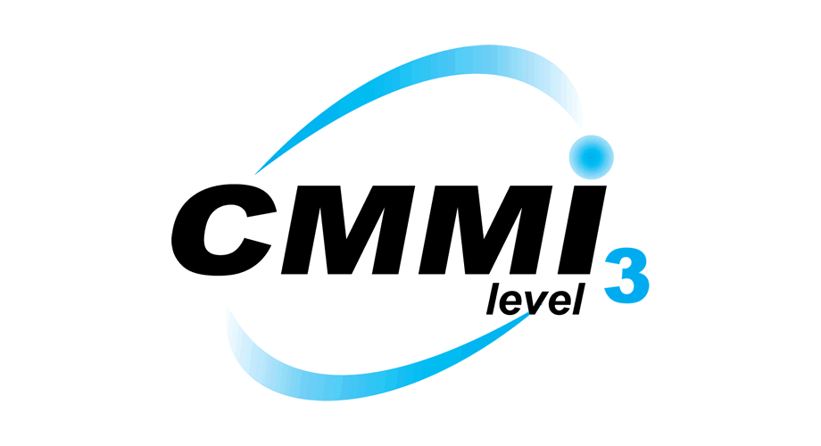


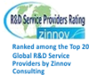
About Aspire
Global technology services firm with core DNA of Software Engineering
3000+ employees; 150+ active customers
Specific areas of expertise around Software Engineering, Digital Services, Testing and Infrastructure & Application Support
Vertical focus among Independent Software Vendors and Retail, Distribution & Consumer Products
International headquarters in Singapore with presence across US, UK, Benelux, Middle East and India
CMMI Maturity Level 3, ISO 9001:2015 and ISO 27001 : 2013 certified
Recognized 10 consecutive times as
“Best Place to Work for” by GPW Institute
Netherlands
A Great Place to Work - 10 Glorious Wins in a Row
Poland
India
Middle East
Certifications
Singapore
Technology Awards
UK
US
Forrester Rated Aspire one of the Top Continuous Testing Service Providers (2017)
Mexico

Slide 4






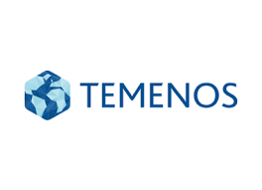
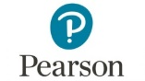






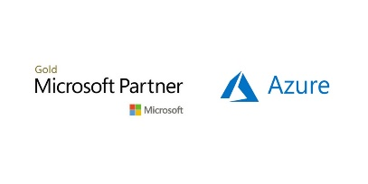
DevOps Practice
PROMINENT CLIENTS
50
Active consultants and
engineers trained in
DevOps Tools and
practices
>
100
Executed and
completed projects in
the past year
25
Current & Active
Customers
PARTNERSHIPS

Slide 5
DevOps - Why us?
Why do organizations approach us?
How do we help?
Experience deploying applications with over 500 self managed containers.
Experience with most of the popular tools and frameworks
Over 50 Seasoned Engineers who can help with automation of deployments and infrastructure management.
Experience in deploying and managing micro-services based applications.
Have helped numerous products and services in increasing the speed of testing cycles, reducing bug count with automated regression testing and improved delivery speed.
Have done tight integrations with project management tools such as Atlassian toolset.
Long testing cycles
Too many delivered bugs
Too many failed releases.
Difficulty managing release notes and stories
Difficulty migrating to cloud
Insufficient cloud strategy
To improve logging and auditing
To implement a workflow for releases
To migrate to cloud services
To migrate between clouds
To build a cloud-agnostic deployment
To migrate to a Microservices architecture

Slide 6








Capabilities (Specialities)
Cloud & Infra
Automation
Micro-Services
Deployment
CI / CD Pipelines
Cloud Migration
and consulting
CAPABILITIES
Productizing CI /
CD pipelines
Database & Queue
Deployments
Hybrid
Deployments
Custom DevOps
Solutions & Portals

Slide 7
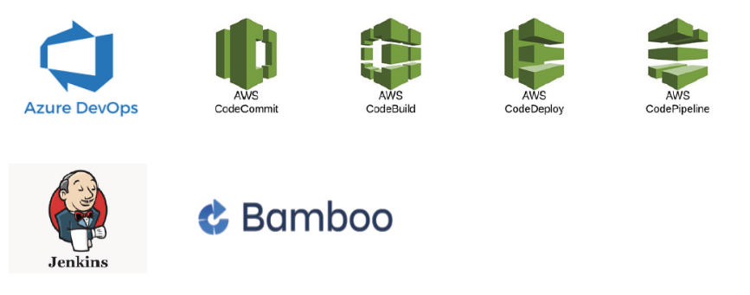
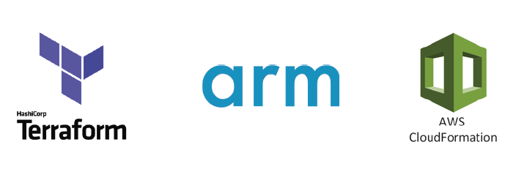
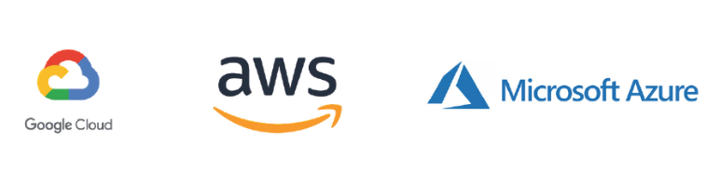
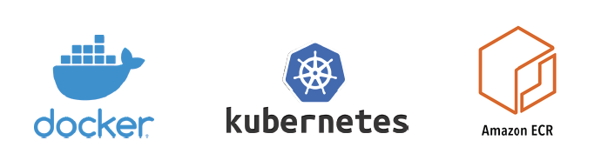
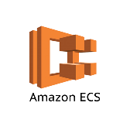

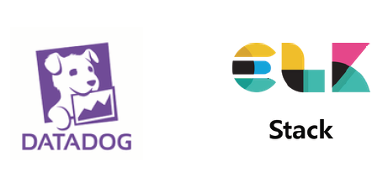
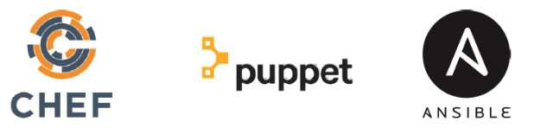
Tools and Skillsets
ORCHESTRATION & CI/CD TOOLS
MULTI-CLOUD DEPLOYMENT & IAC
CLOUD AND INFRA MANAGEMENT
CONTAINERIZATION
LOG AND SEARCH FRAMEWORKS
CONFIGURATION MANAGEMENT

Slide 8
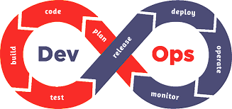
Philosophy & Approach
EA, security
Developers
Ops
Precommit checks
Static code analysis
Peer code review
Build
IaC
Unit test
Developers
Merge to trunk
QA
VCS
Business
Integrated build
Backlog
Design ideas
RM
Artifact repository
laC
Application and operational analytics
Customer
Release automation
Release decision
Manual QA
API-based test automation
Release automation
Service and network virtualization
Test data management
EA
TDM
EA
Deployed applications
Business
QA
Developers
Ops

Slide 9
DevSecOps
Source control software usage, cloning and branching.
Retention policies for Local clones.
Periodic Scanning other public GIT repositories for Sensitive information leak.
Branching Strategy and protection
Branching Strategy and ownership are defined right at the beginning
Feature based branching is recommended.
Unused branches are deleted as frequently as required by process.
Release Management
All releases are created and managed by build processes only. Users are not provided upload access to any of the artifact repositories.
Access to Releases
Releases are created by artifacts and processes
Releases/ artifacts are almost always immutable
Release/artifact retention policies
Old releases/artifacts are archived frequently.
Environments
Each environment is protected by network protocols and access permissions.
Each environment belongs to a team and are typically managed in separate sub networks.
Approval to move releases to the next environment is generally reserved to managers of the owning team.
Individual Deployments
Temporary deployments are terminated as soon as possible in an automated manner.
Open ports and other access mechanisms are reviewed frequently and are opened only to authorized processes and networks
Network related
Firewalls, VPNs and other security protocols are enforced at all times.
Process Related
Sensitive teams that follow security guidelines.
All processes and processing software (such as Jenkins) are considered in the security plan.
All programmatic access is provisioned with a separate user id / api key to track usage.
All Keys and passwords are enforced to change every month.
Protection of Source Code
Protection of Artifacts
Protection of Deployments
Network and Process

Slide 10
Value Adds
PROPEL
TECHCELLO
Centrally managed
MULTI-CLOUD
Deployment Portal
Multi-tenancy framework
that gives tenancy, billing,
log mgmt and many more.

Slide 11

Value Adds - PROPEL Explained
FEATURES
Cloud
MULTI-CLOUD DEPLOYMENTS
Enabled by a variety of cloud deployment engines, Propel enables deployments on all popular cloud platforms
Devops Portal
Cost
Explorer
Devops
Microservice Build/ Release
Predefined Build Release Pipelines,
Predefined
Docker
Build/ Release Server Adapters
TEMPLATE DRIVE
Backed by IaC templates, a generic
template can be created as an
abstraction to individual IaC templates
CD
Predefined lac Templates
VSTS/Jenkins
Cloud Deployment Engines
Microservice Cluster Deployment
IMMERSIVE PORTAL
A dashboard of information that covers the entire gamut of development operations
Introduces the idea of cloud agnostic deployments
Easy to utilize and leverage
API based services that allow Integrations
Benefits

Slide 12
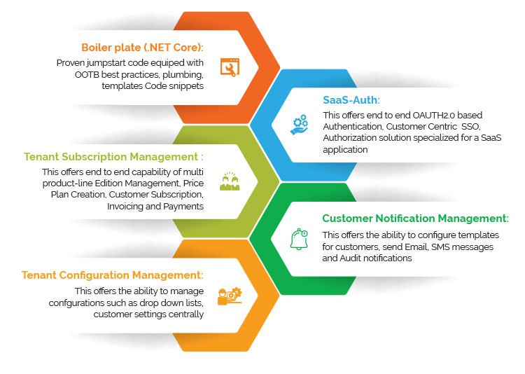
Value Adds - TECHCELLO Explained
FEATURES
Multi-Tenancy & SaaS - Out of the box
TechCello is an SaaS enabler framework that can help introduce multi-tenancy without the hassle of building something new.
Billing, Identity Management & many more
TechCello provides Identity management, billing, metadata service, auditing, logging, licensing and many more features that can help anyone build a SaaS application quickly
UI & Dashboard with Admin controls
TechCello comes with an Admin console and a portal to allow management and querying the data.
Pluggable Multi-tenancy
All associated features required for self subscription
Benefits

Slide 13
Our Engagement Model
Parameters
Resource
Oriented
Requirement
Oriented
Managed Platform Services
Working model | Resources deployed based on the Client’s requirements | Package of tasks based on the Client’s requirements | Managing DevOps platform
Duration | SLA focused approach to achieve business goals | Time and Material approach | Annual Contract
Global Delivery model | Onsite, Offshore and Near shore | Onsite, Offshore and Near shore | Onsite, Offshore and Near shore
Cost | Fixed monthly fee based on number & skills of resources deployed | T&M or Fixed Cost based on mutually agreed SOW | Annual cost along with Service level agreement
Team composition | Solution Architect and DevOps Engineers | Solution Architect and DevOps Engineers | Solution Architect and DevOps Engineers
Availability | Time zone specific | Flexible work timings | 24x7 or time zone specific

Slide 14
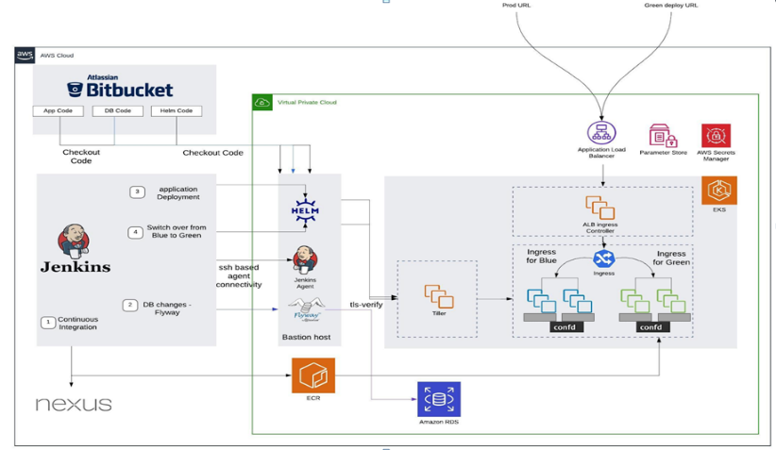
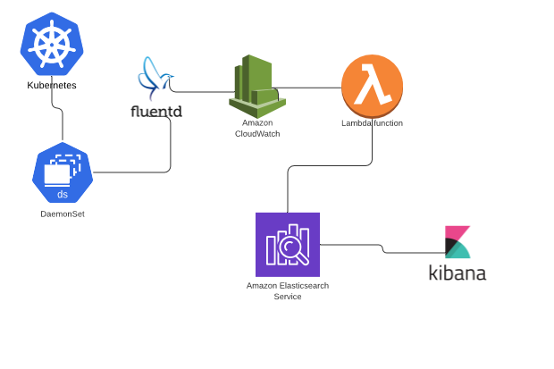
Experiences
Case 1 – Migration to AWS on Containers
Deployment architecture
Aspire worked with a world’s leading education publishing and assessment service provider that recently sold-off its US courseware division to a private equity firm. This strategical move, required that some of their applications had to be moved to AWS cloud in a containerized . Aspire systems came up with a program called “Trio Migration” involving administrative migration, data center migration and Database migration.
Features
Container based micro-services architecture
The applications that were migrated were refactored and rebuilt as docker containers that were then pushed to ECR. The containers are part of a larger micro-services architecture that provides for resilience of the application.
Log Aggregation
Centralized Log Management
Application logs are streamed from containers to Cloudwatch using Fluentd. Once logs reach Cloudwatch, lambda functions are used to stream the logs from Cloudwatch to Elastic search. Here we use AWS native service (combination of Elastic search & Kibana)
Kubernetes managed deployments
All container deployments and clusters are managed by Kubernetes (Amazon EKS) where machines are monitored, auto-scaled and auto-healed.
Full fledged micro-services architecture
Containers that enable autoscaling and self healing
Easy upgrades
Centralized Logging
Benefits

Slide 15
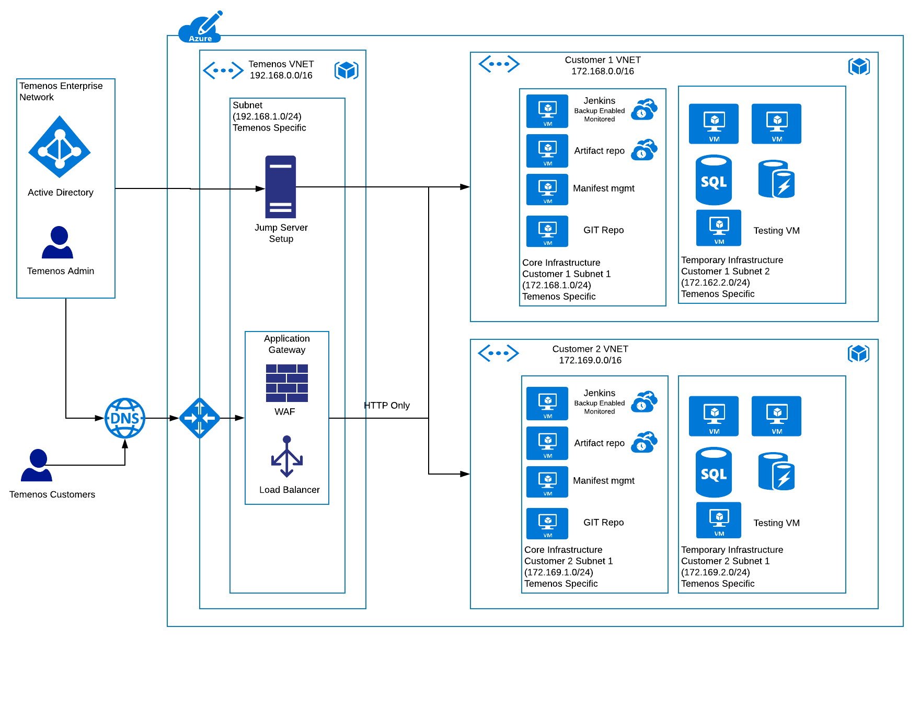
Experiences
Case 3 - DevOps as a service
Deployment Architecture
As an industry leading banking product, there were
requirements testing customizations by each and every
customer. To standardize the testing process, the internal
DevOps Testing practice had to be extended as a service
to its customers On Azure
Features
Multi-Tenant
As the solution was provided to banks, it had to address very stringent security concerns and data and process isolation was a primary requirement. So, the solution was built in a way that each customer could choose the infrastructure and process needed on an adhoc basis.
Testing as a Service
With the deployments automated, the testing of the product along with all customization was also automated.
Revenues in the form of Licenses for the tool
Improved Quality
Enhanced capabilities to upgrade and customize
Generalized Testing practices to allow easy
adoption for all customers
Benefits

Slide 16
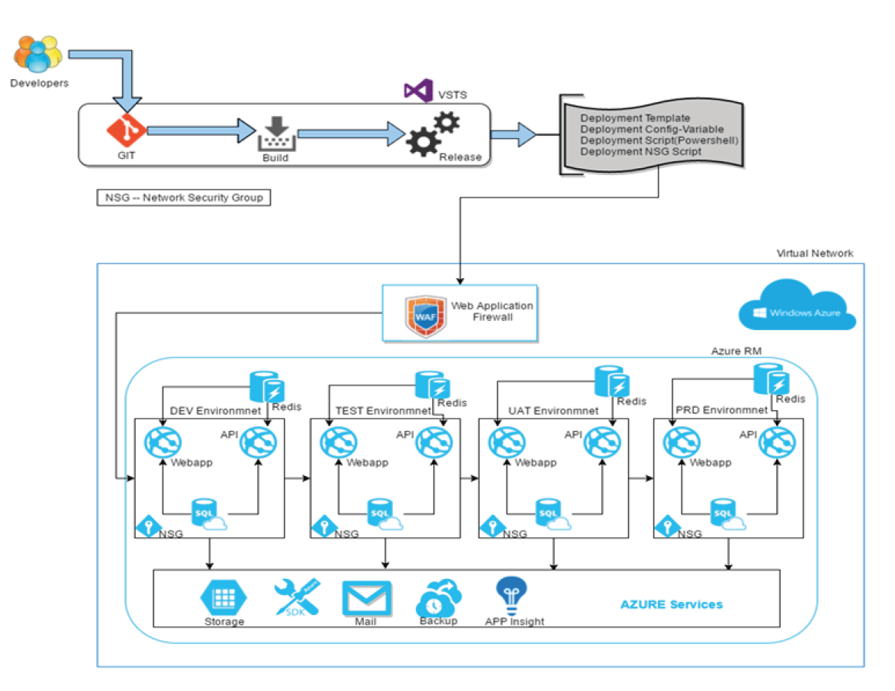
Experiences
Case 2 - CI / CD On Azure
Deployment Architecture
Aspire worked with an Industry leading consulting firm and enabled it to build its products and services on Azure. With its clientele, there was no margin for error and no quarters for manual triages. So we built a complete platform with the following features
Features
Approval based deployment workflow
A clear CI & CD use case with multiple stages of deployment to filter out bugs and issues. Each stage had an approval mechanism to enable a ledger of approvals.
Cloud Services for all Data
All data storage was cloud managed with geo replication and regular backups.
Automated deployments
All Deployments and upgrades were automated and the entire flow was done without manual intervention.
Full fledged multi-tenant application ecosystem
Reduced Production Defects
Improved Efficiency
Improved Traceability
Benefits

Slide 17
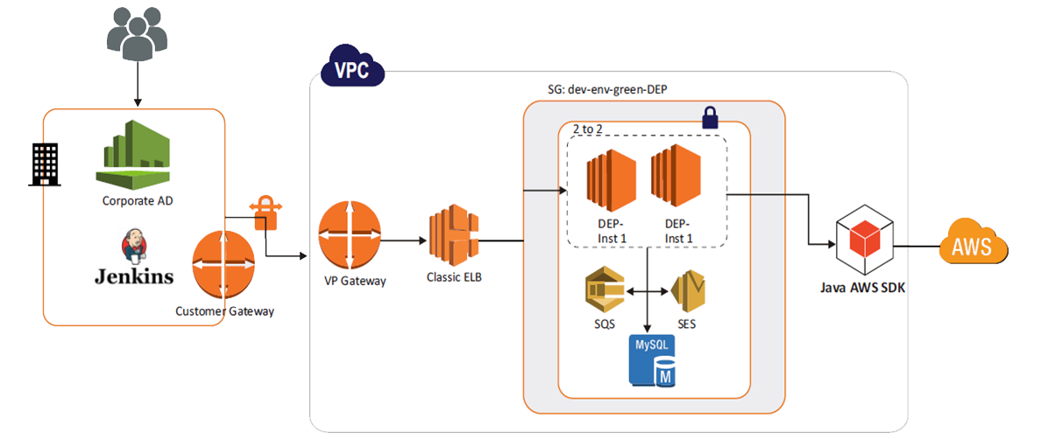
Experiences
Case 4 - DevOps as a service
Deployment Architecture
A US based insurance product company required self provisioning capabilities for their own product to enable internal teams to self provision instances of their product on AWS. Aspire helped them design build a self provisioning portal using required AWS tools.
Features
Multi-Tenant portal
Aspire built a microservices based multi-tenant portal using Spring Boot, Netflix OSS and Angular. The automation of deployment was done using a variety of AWS based DevOps tools
Automatic deployment using AWS tools
The Java based product was built and deployed into various environments using AWS Cloud Formation, Code Build, Code Pipeline and a few other tools.
Pluggable framework for testing tools
The automation framework enabled post-scripts to be executed to allow running any test tools post deployment. This helped development teams to integrate and sequence the deployment with test tools.
The self provisioning tool freed up the DevOps team
Improved efficiency for development teams
Pluggable architecture for enabling Dev Teams to plug a variety of testing tools
Benefits

Slide 18
Articles and Case Studies
Microservices
Advancement in Microservices Architecture
https://www.aspiresys.com/WhitePapers/advancement-in-microservices-architecture.pdf
Are Microservices the real game changer to product-driven businesses?
https://www.aspiresys.com/WhitePapers/are-microservices-the-real-game-changer-to-product-driven-businesses.pdf
Microservices: The Next Logical Step to Grow Your SaaS Business
https://www.aspiresys.com/WhitePapers/microservices-next-step-to-grow-your-saas-business.pdf
Containers:
Containers’ security: A critical control in DevOps implementation
https://blog.aspiresys.com/infrastructure-managed-services/containers-security-a-critical-control-in-devops-implementation/
Making Infrastructure as Code a Better framework with Containers
https://blog.aspiresys.com/infrastructure-managed-services/devops/making-infrastructure-as-code-a-better-framework-with-containers/
Getting Real with Containers – How to ace the pace of cloud migration
https://blog.aspiresys.com/infrastructure-managed-services/getting-real-with-containers-how-to-ace-the-pace-of-cloud-migration/
A Peep into the realm of Kubernetes Security in applications: Enroute to our expert talk
https://blog.aspiresys.com/infrastructure-managed-services/a-peep-into-the-realm-of-kubernetes-security-in-applications-enroute-to-our-expert-talk/
Why CIOs need to adopt containers?
https://blog.aspiresys.com/infrastructure-managed-services/why-cios-need-to-adopt-containers/

Slide 19

Q & A

Slide 20

Thank You

